Slide 1
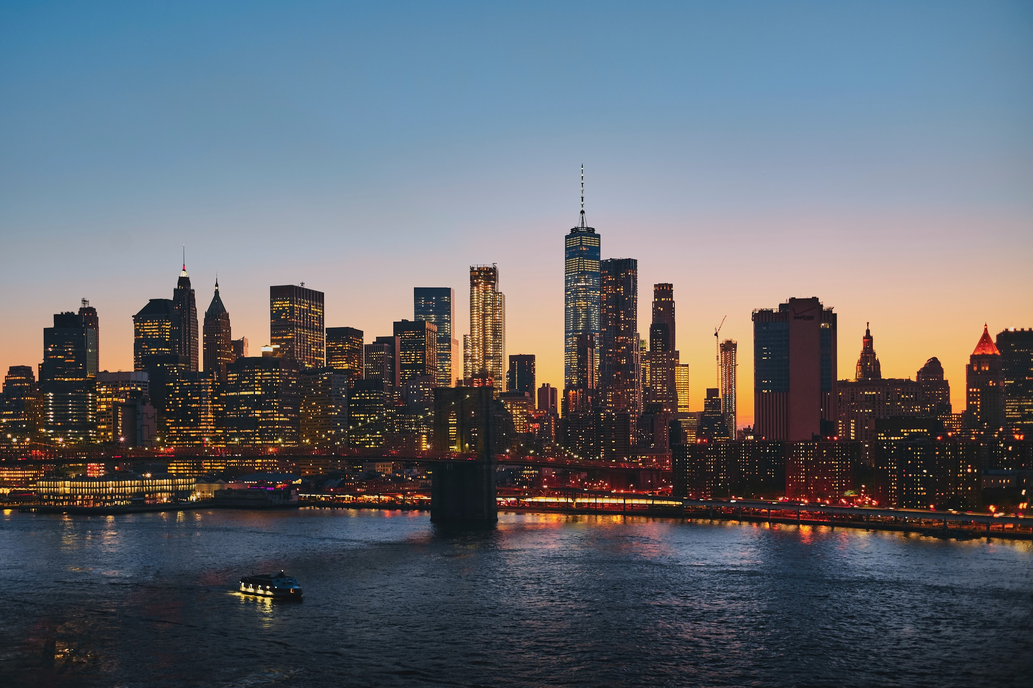

COVID-19 Effect on NYC Crime
Mei Tak Lee
Shany
Lajara
Tanzil
Baraskar
Virgil
Latorre

Slide 2

AGENDA
Project Introduction
Crimes and Covid-19
Top 4 Crimes - Observations and Insights
Recommendations
Metadata

Slide 3
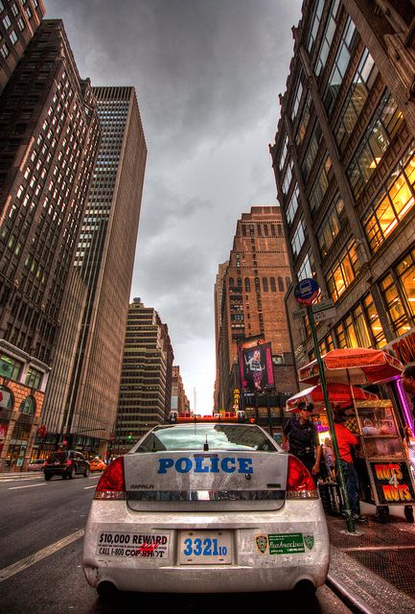
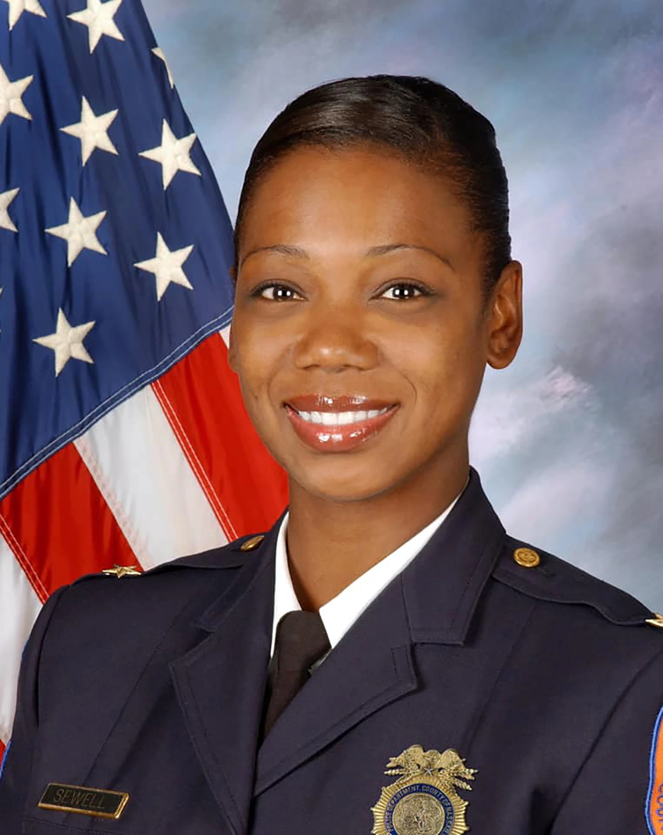
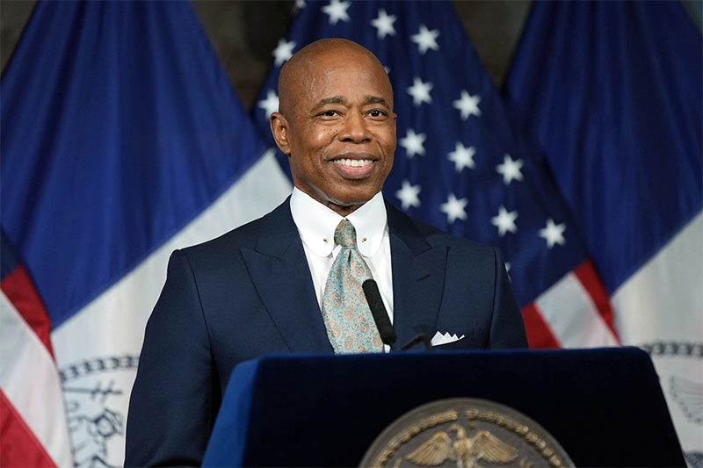
PROJECT INTRODUCTION
Our goal
Investigate which areas of New York City have high crime rate
The effects of Covid-19 on crime rates in New York City
Give suggestions and recommendations on how to keep NYC safe
Our clients
The Mayor of New York City, Eric Adams
The commissioner of NYPD, Keechant L. Sewell
They both want us to help improve the crime situation that is happening in NYC

Slide 4

Dataset Preview
This dataset is from the New York City Police Department
Dataset is filtered from 2017 to 2021
Information on:
Date of crime
Gender / Age / Race
Location of crime / Precinct number
Description of crime / Crime code

Slide 5
LET'S OBSERVE CRIME IN NYC

Slide 6
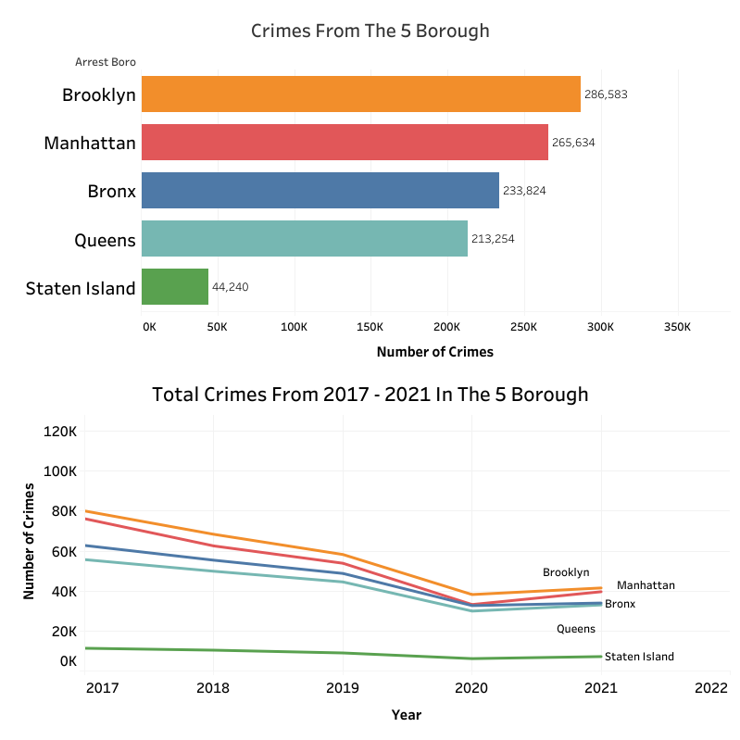
Crimes in NYC
Brooklyn had the most crimes from 2017 to 2021
Less crimes during Covid compared to pre-pandemic
Crimes are on the rise during Covid/after in all boroughs

Slide 7
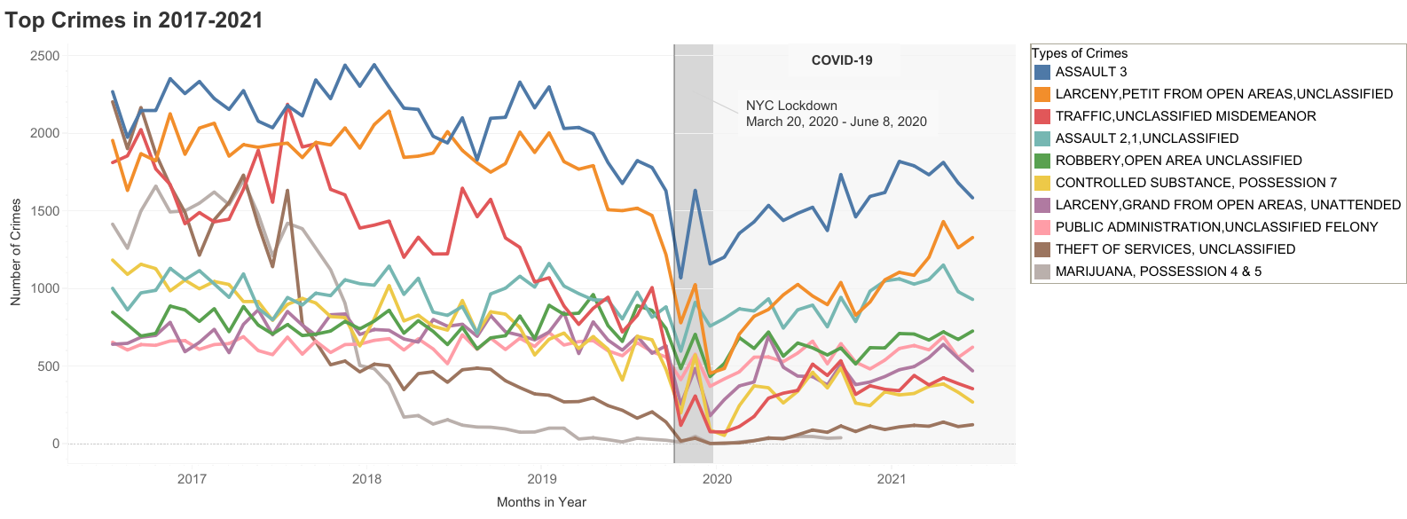
NEW YORK TOP 10 CRIMES 2017-2021

Slide 8
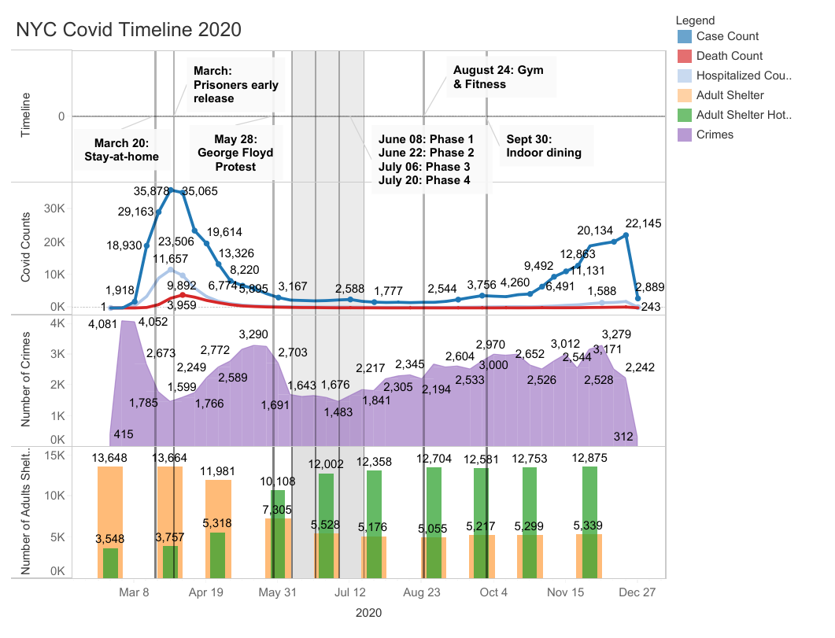
January - Bail reform law went into effect. No cash bail needed for misdemeanor and nonviolent felonies
March 20 - Stay-at-home order declared closing all non-essential businesses
March - Thousands of prisoners released early due to covid infection
April - Homeless moved from shelter to private hotels
May - subway service and station overnight closure for cleaning
May 28 - June 30 - A series of George Floyd Protests
June 8 - Phase 1: construction, manufacturing, agriculture, forestry, fishing, and select retail that can offer curbside pickup
June 22 - Phase 2: outdoor dining at restaurants, hair salons and barber shops, offices, real estate firms, in-store retail, vehicle sales, retail rental, repair services, cleaning services, and commercial building management.
June 24 - 14-day self-quarantine required for travelers from areas with high infection rates
July 6 - Phase 3: personal care services.
July 20 - Phase 4: low-risk outdoor activities at 33% capacity (outdoor zoos, botanical gardens, nature parks, historical sites, outdoor museums, etc.)
August 24 - Gym and fitness center at 33% capacity with mask mandate
September 30 - Indoor dining at 25% capacity
*While covid was on the rise at the beginning of the lockdown, overall crimes were down. When the city started reopening crimes were on a steady rise.
Values for adult shelter (orange) and adult shelter commercial hotel (green) are not combined. Data in monthly basis.

Slide 9
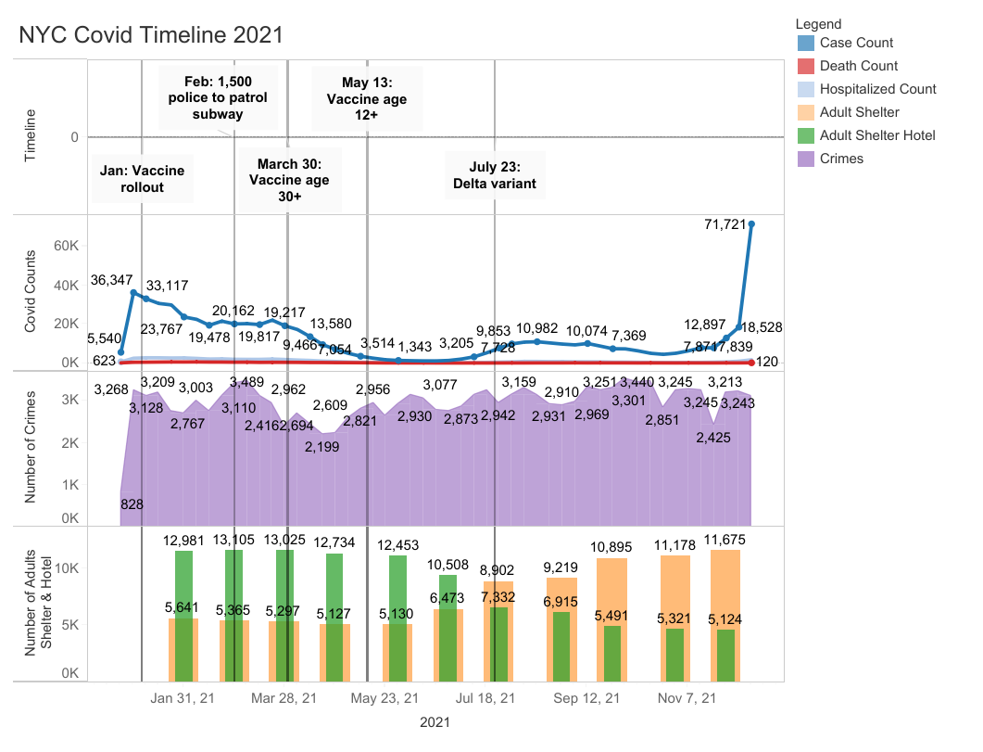
January - Covid-19 vaccine for essential workers and age 75+
March 10 - vaccine rollout for 60+
March 23 - vaccine rollout for 50+
March 30 - vaccine rollout for 30+
April 6 - vaccine rollout for 16+
May 13 - vaccine rollout for 12+
February - The MTA requested an additional 1,500 police after two subway riders were killed
June - Moving the homeless back from hotels to shelters
July 23 - Delta variant became the dominant strain
August 3 - proof of vaccination for workers and customers at all indoor dining establishments, gyms, entertainment venues, and performances
December 25: Omicron variant become dominant strain
*Overall crime rates are steady for 2021.
Values for adult shelter (orange) and adult shelter commercial hotel (green) are not combined. Data in monthly basis.

Slide 10

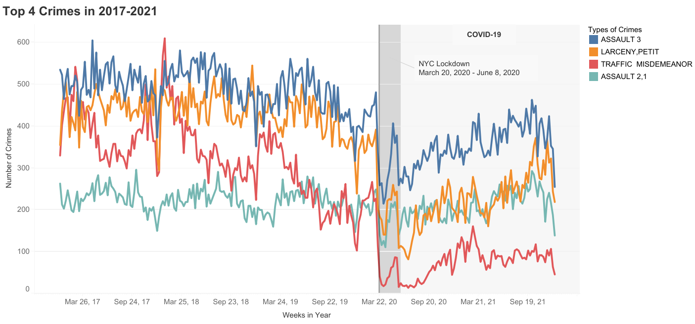
TOP 4 CRIMES IN NEW YORK
[2017-2021]
3rd Degree Assault
2nd & 1st Degree Assault
Traffic Violations
Larceny

Slide 11
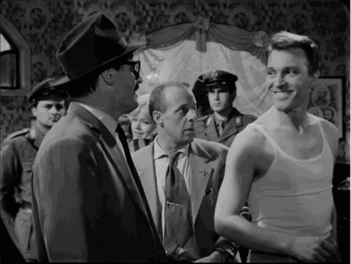
3rd Degree Assault
The most minor form of assault where a person
Intentionally physically injure another person
Injure a third party when a person intended to injure another person
Negligently injure another person using a deadly weapon or dangerous instrument
Recklessly injure another person
New York Penalty:
Jail time of up to one year
Fine up to $1,000
Examples:
Domestic violence
A bar fight, punching a person which causes a black eye
Accidentally hurting someone while whipping a baseball bat

Slide 12
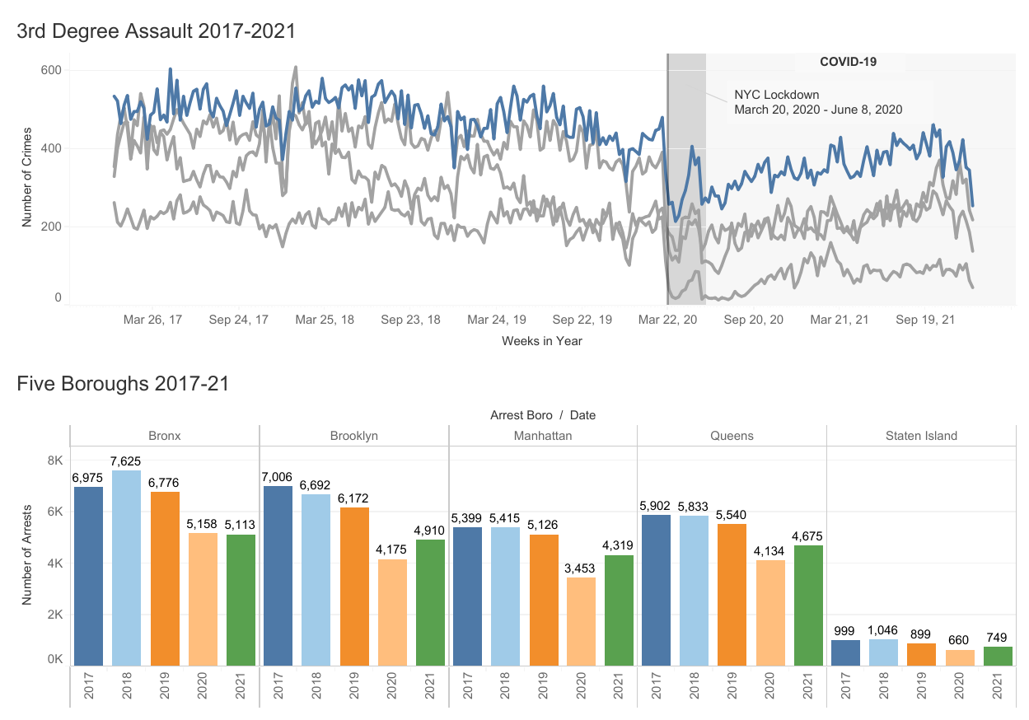
3rd Degree Assault - Observations
Overall number of assaults decreased during Covid
Bronx had the highest number of arrests but did not improve or worsen between 2020-21
Besides the Bronx, all boroughs increased in assaults between 2020-21

Slide 13
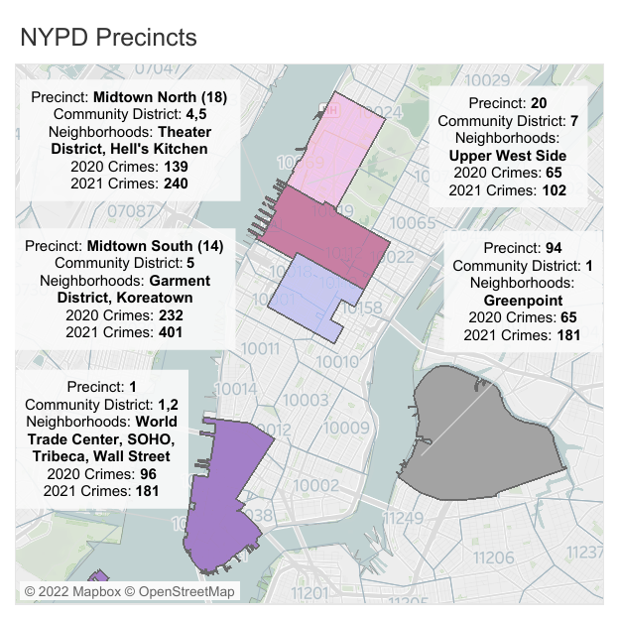
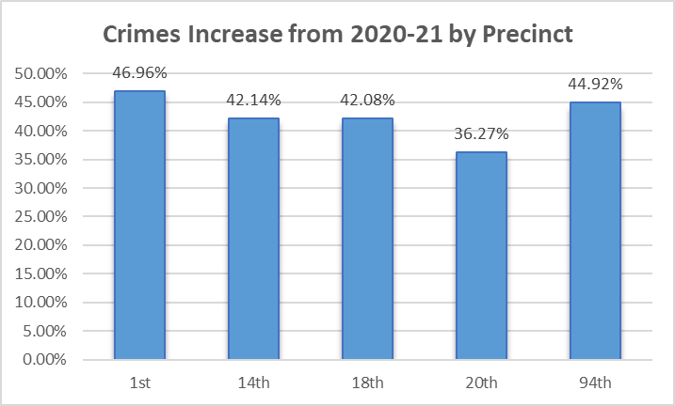
3rd Degree Assault - Observations
The locations shown do not have the most assaults but has the most increased between the two years.

Slide 14
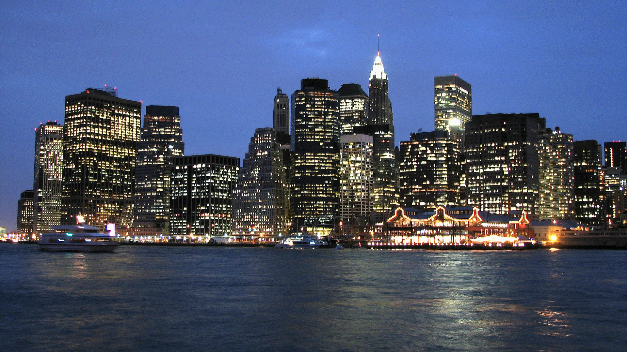
3rd Degree Assault - Observations
Financial District & Lower Manhattan (Community District 1 & 2):
Offices and headquarters of major financial institution
New York Stock Exchange
Federal Reserve Bank of New York
Major tourism
World Trade Center (9/11 Memorial)
Wall Street
Residential (Battery Park City, Greenwich Village, SOHO)
Age: <18 (18%), 18-64 (71%), 64> (12%)
Ethnicity: White (66%), Asian (17%), Hispanic (8%), Black (5%)
Education: Bachelor’s degree or higher (81%)
Housing Occupancy: 76% occupied, 24% vacant
Median Household Income: $142,543

Slide 15
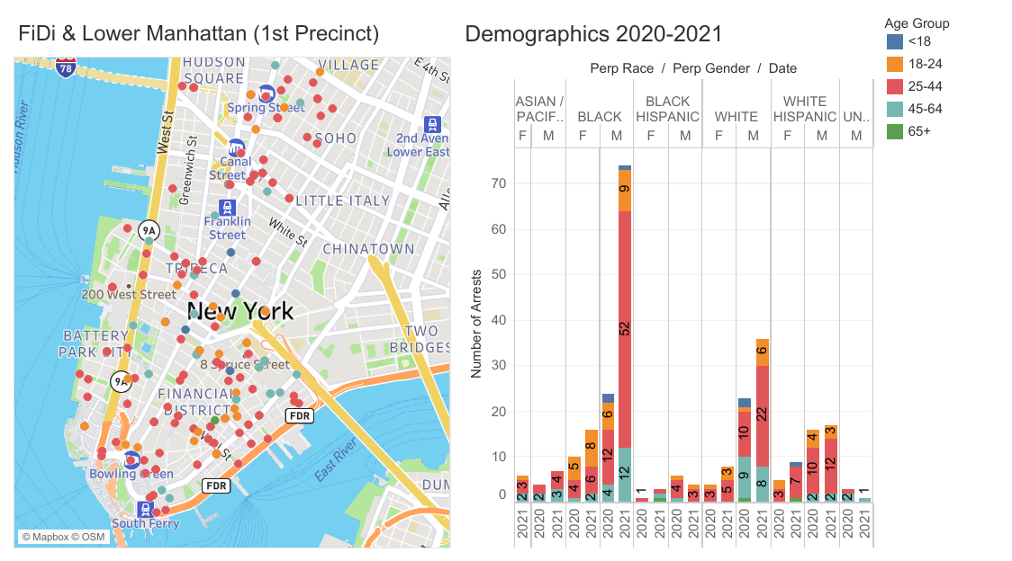
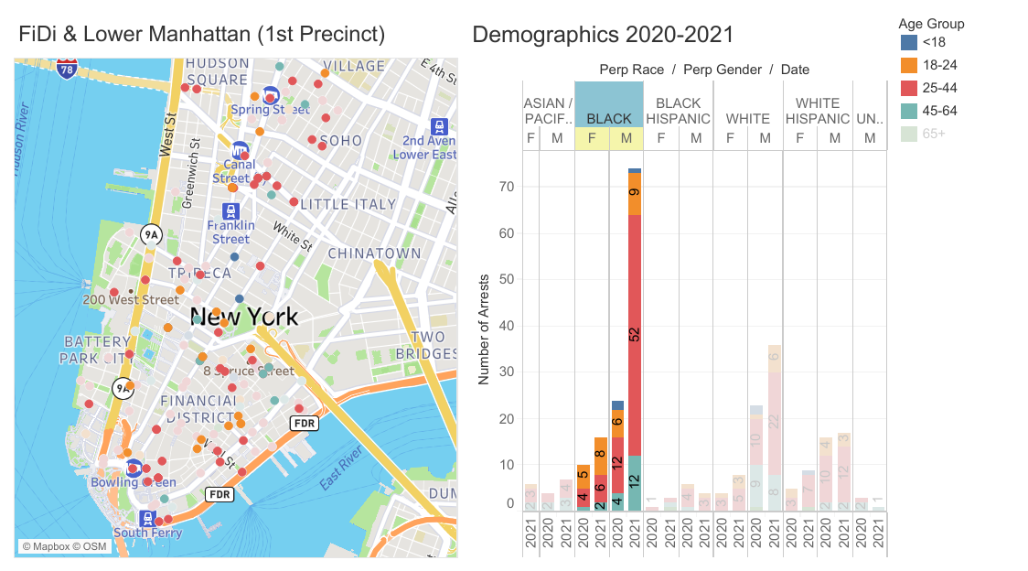
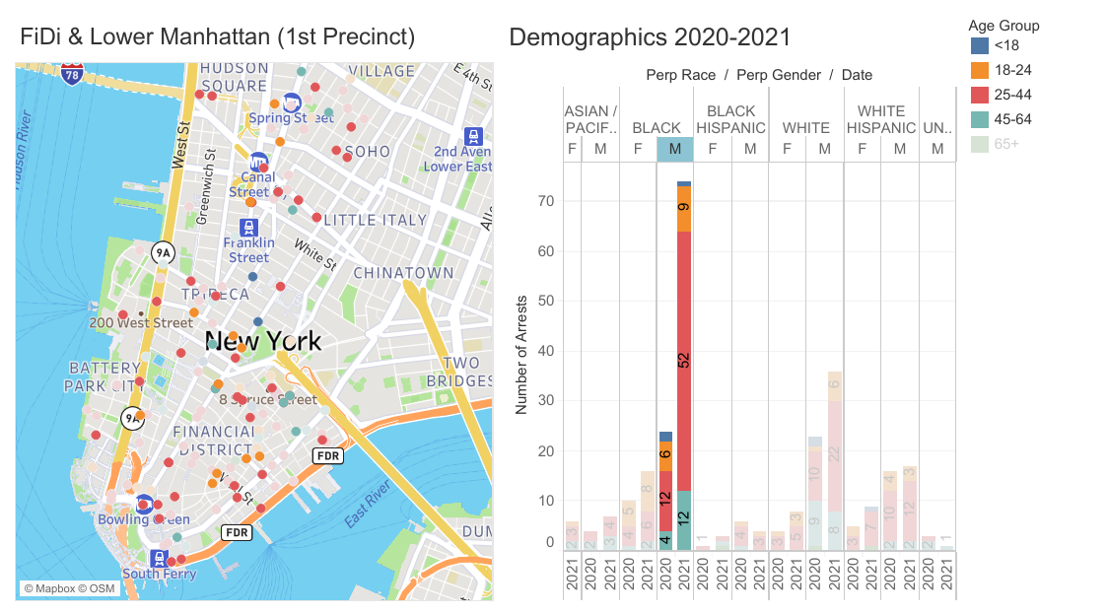
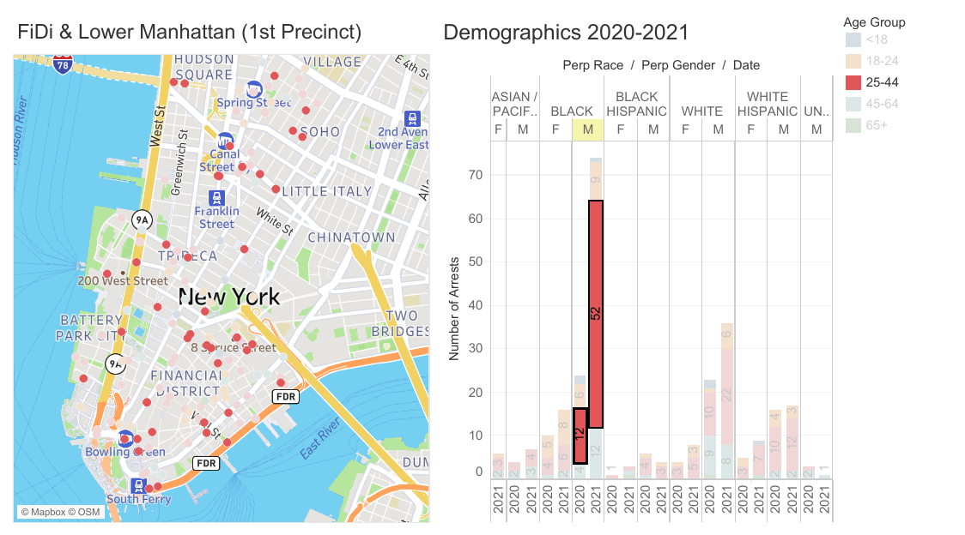
3rd Degree Assault - Observations
Majority of assaults are committed by
Black
Male
25-44
Location of assaults
Near subway entrances
Retail stores
Landmarks

Slide 16
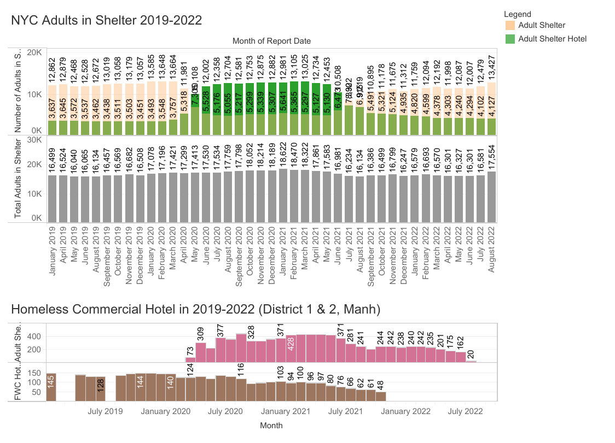
3rd Degree Assault - Insights
The number of increased in homeless adults staying in hotel might be from newly released prisoner or unsheltered adults on the streets
Up to 400 homeless adults were moved to hotels in the Financial District and Lower Manhattan
Homeless adults might be a factor in increased in assaults
Drug problems or mental illness without treatment
Remained on the street instead of a shelter after hotel stay
Impact of Covid-19 causes anxiety and depression among New Yorkers
Individuals who lost loved ones or has financial stress are more likely to experience behavioral health problems
*Adult shelter numbers include both male and female. The grey chart is a total of adults in shelter (orange) and adults in commercial shelter (green).
*Homeless adults in commercial hotels (red). Family with children in commercial hotels (brown)

Slide 17
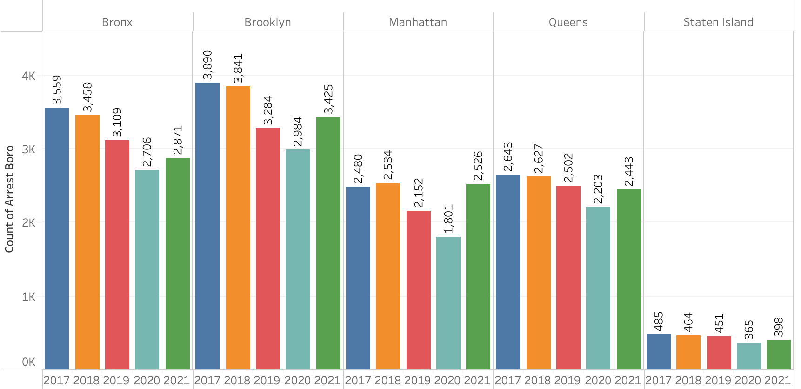
1st & 2nd Degree Assault
Assault in the First Degree, Penal Law 120.10, is without exception the most devastating of these charges regardless of whether you are faced with a felony arrest, indictment or trial.
Assault in the First Degree is a “B” violent felony with a sentence up to 25 years in prison and a minimum of five years in prison.
Example: intentionally cause a serious physical injury to another person and you use a deadly weapon or dangerous instrument to do so.
Assault in the Second Degree, Penal Law 120.05, is a vastly more dangerous crime than the lesser misdemeanor offense. In fact, this degree is a “violent felony offense.”
Assault in the Second Degree is a “D” violent felony and is therefore punishable by time in state prison – a presumptive mandatory two years up to seven years or five years probation.
Example: evidence establishes your intent to cause, and you in fact caused, a “serious physical injury.

Slide 18
1st & 2nd Degree Assault most affected boroughs

Slide 19
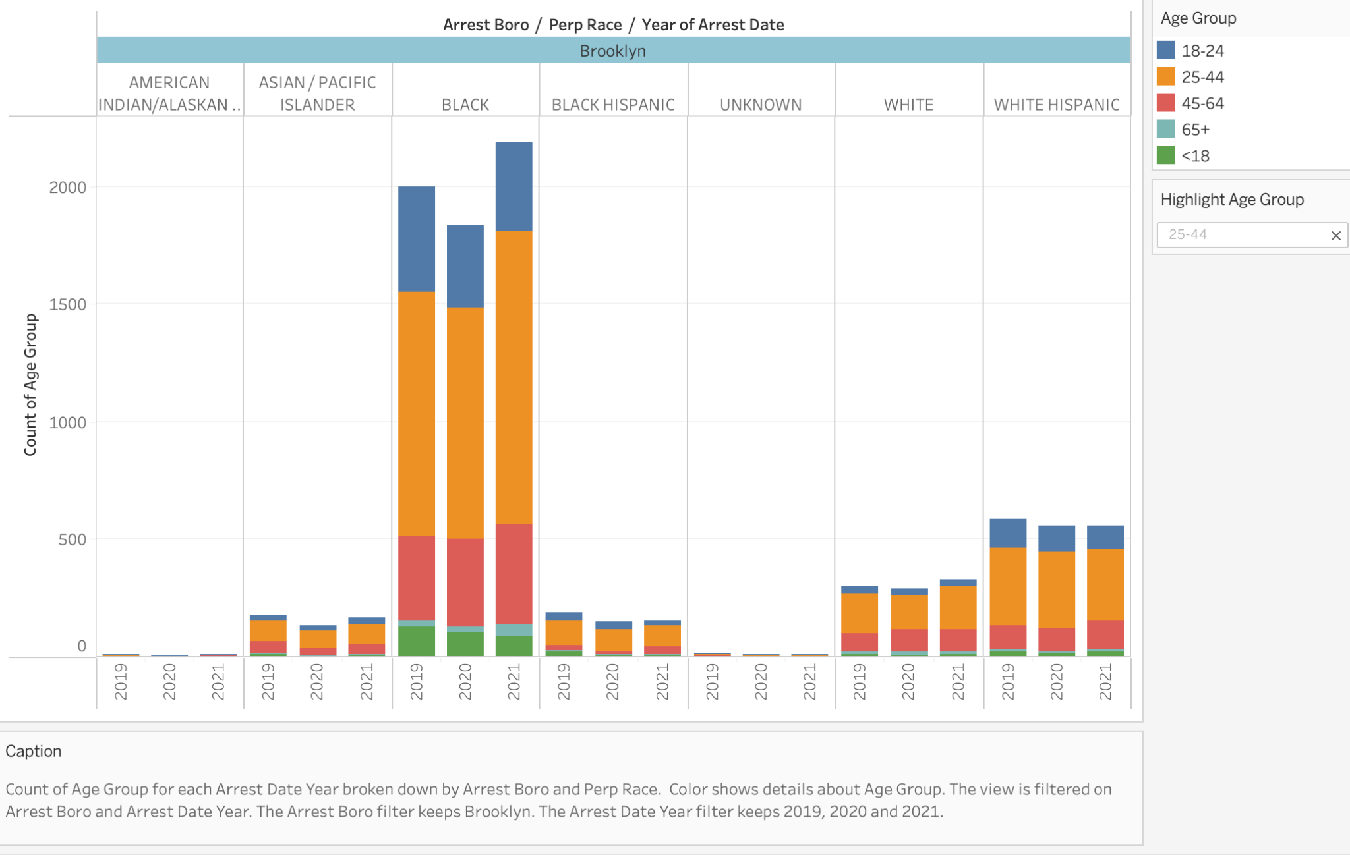
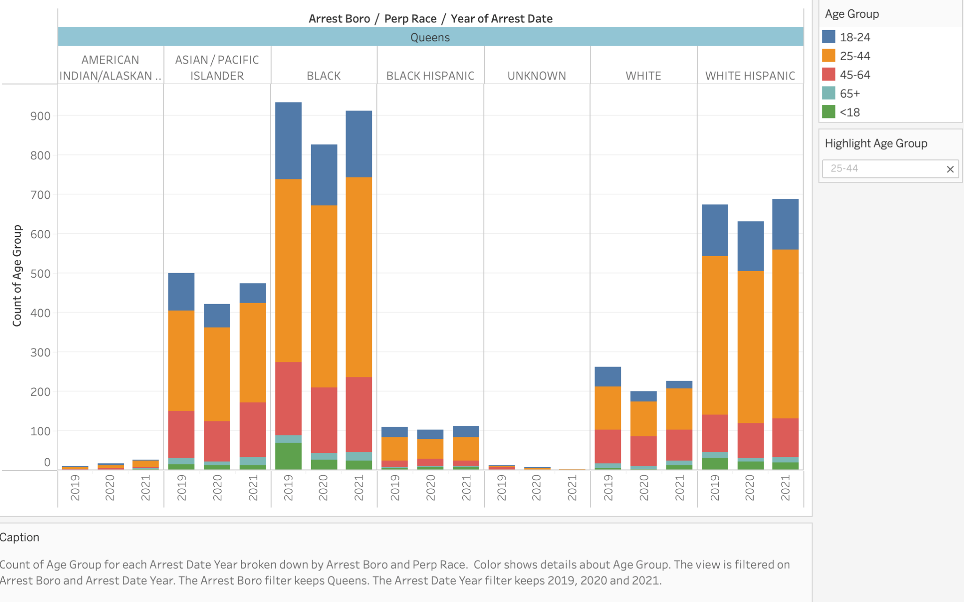
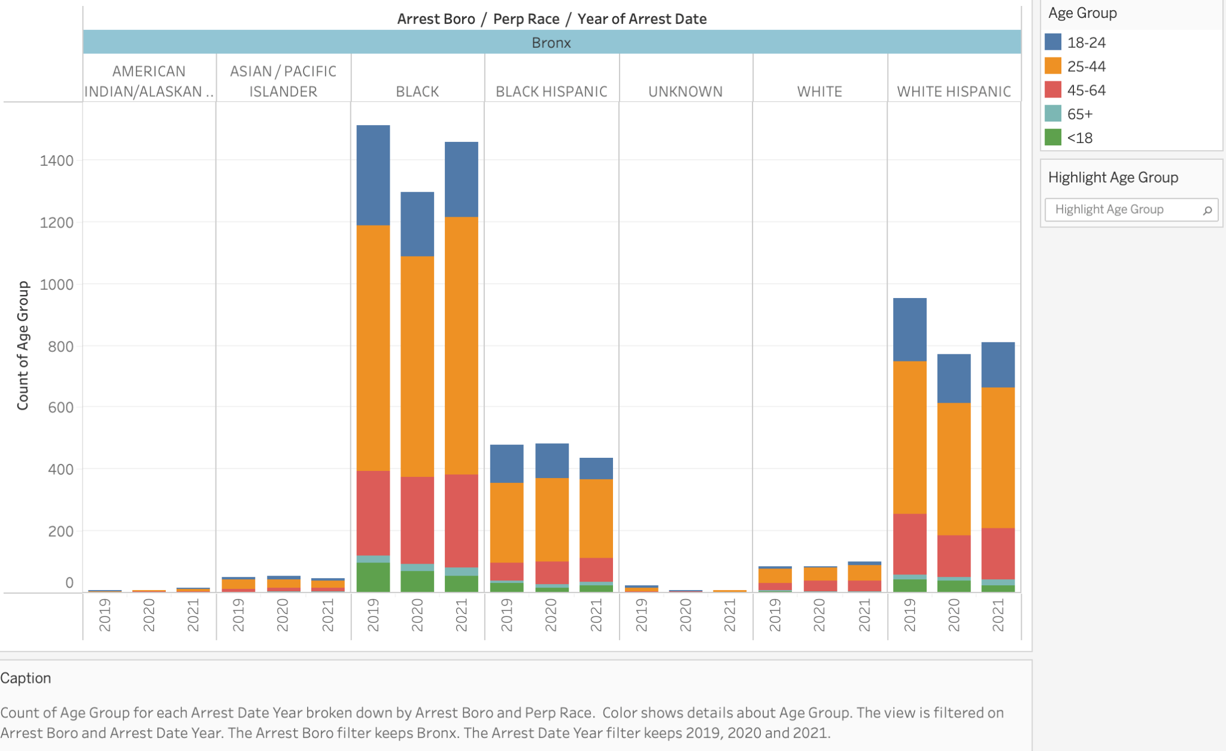
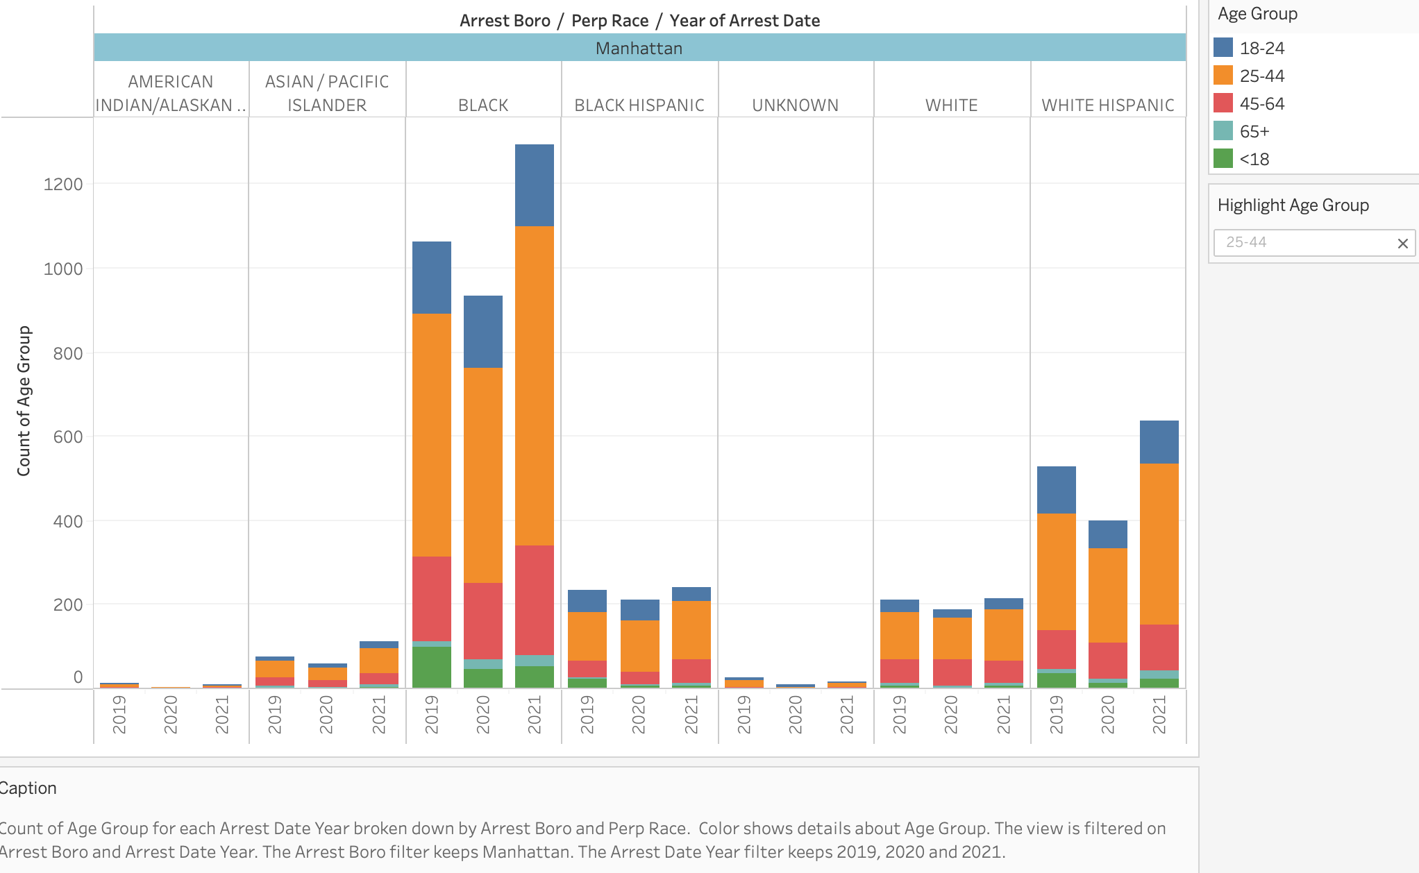
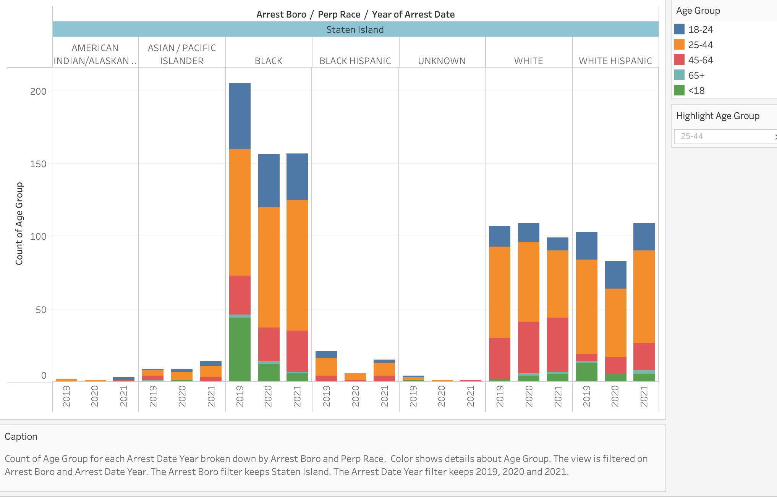
OBSERVATIONS: 1st & 2nd degree assaults by race and age
In the 5 New York boroughs:
From 2019 to 2021
The majority of 2nd & 1st degree offenses were committed by ‘Black’ males and females between the ages 25-44.
Followed by ‘White Hispanics’ ages between 25-44.

Slide 20
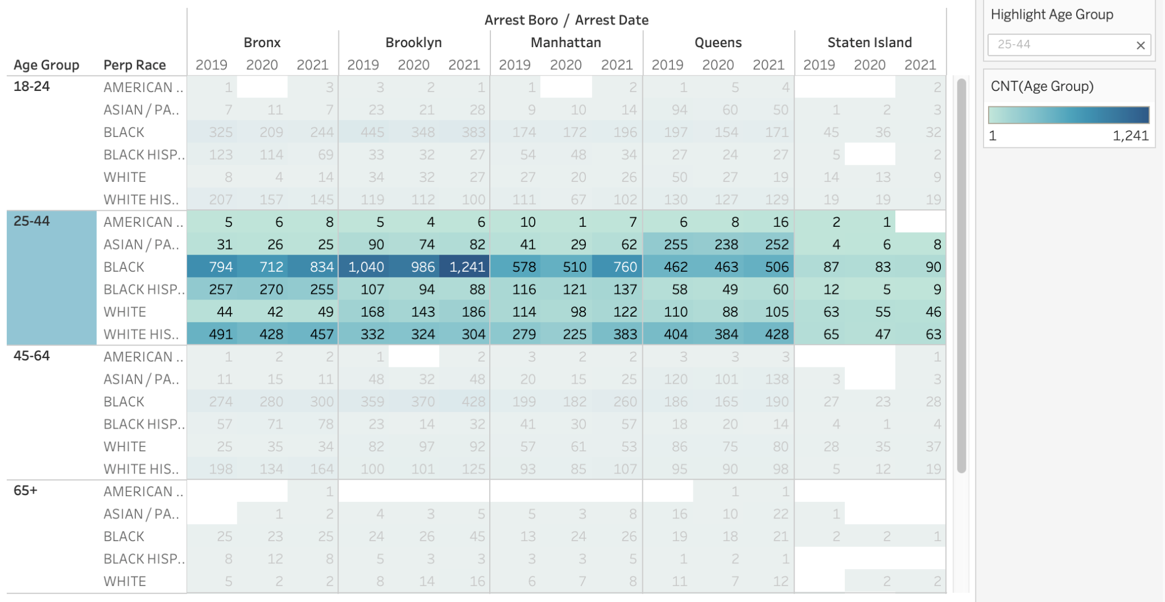
OBSERVATIONS: 1st & 2nd degree assaults
A decrease in assault numbers can be appreciated in 2020 due to Covid-19 hospitalizations, Covid-19 restrictions and pandemic measures taken at each borough.
The decrease in crime coincide also with the “Stay-at-home order” in New York State, which took effect “On March 20, with 5,683 confirmed cases in NYC, the governor's office issued the PAUSE order that would go into effect on March 22 at 8 PM”
However, as city started reopening in 2021, crime increased

Slide 21
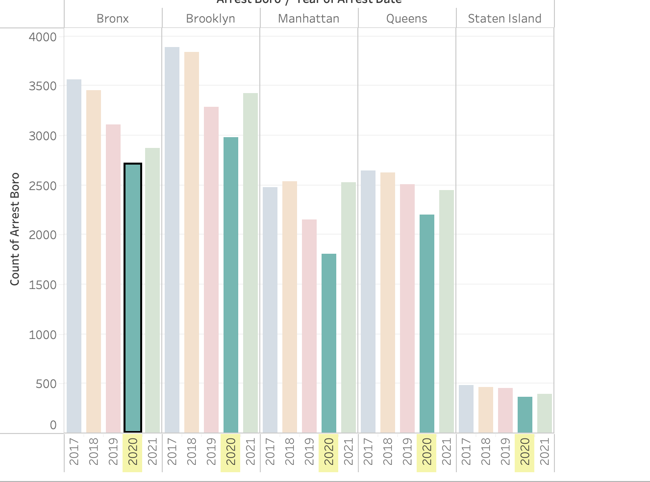
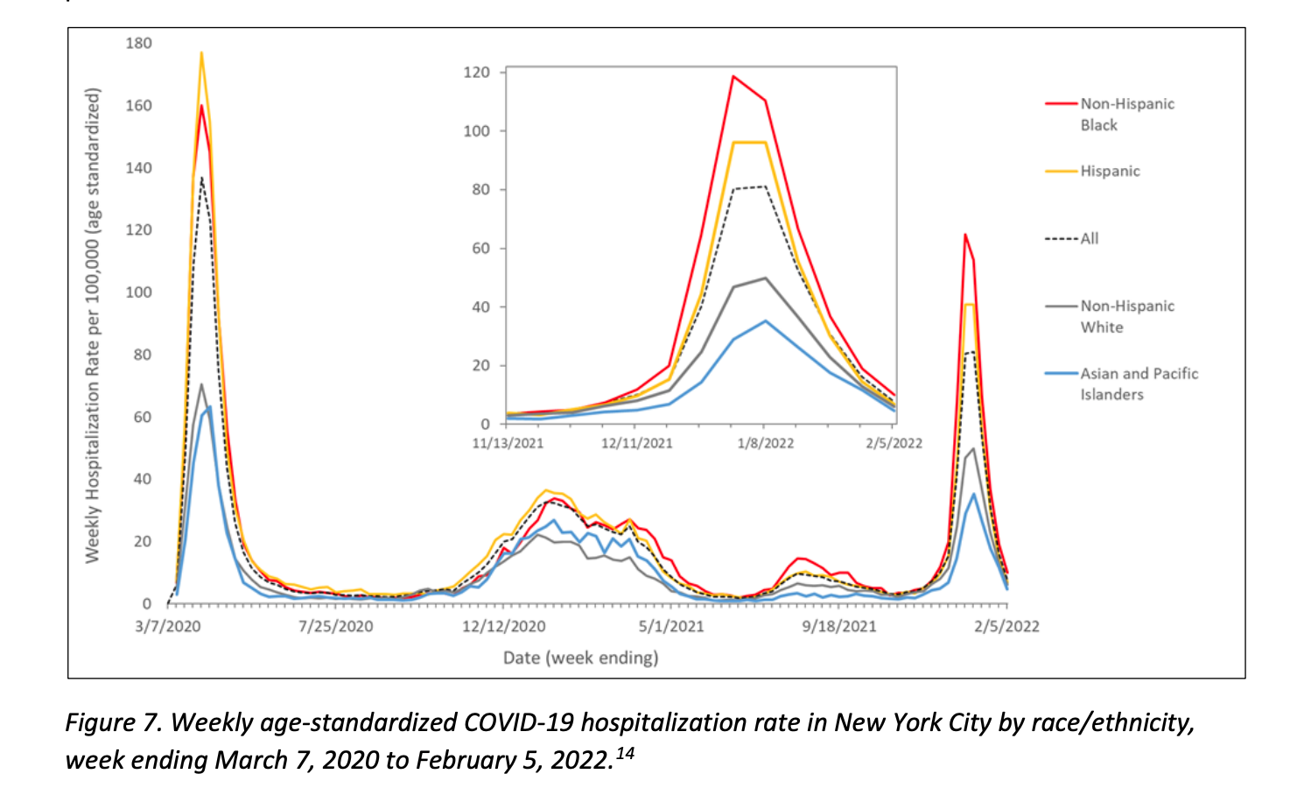
OBSERVATIONS: 1st & 2nd degree assaults vs Covid-19
In 2020 the most affected boroughs with Covid-19 Hospitalization also were:
Brooklyn: 7, 722 hospitalizations
Queens: 8,910 hospitalizations
Bronx: 6, 223 hospitalizations
The same boroughs with the most 2nd & 1st degree assault crime rate committed by Black Males and White Hispanics. Which decreased with covid hospitalizations of the same.
Covid-19
Hospitalizations spike on
[April 2020]
“We must next consider the factors that have led to increased rates of hospitalization. Inequities in access to effective outpatient COVID-19 treatment can lead to missed opportunities to prevent severe COVID-19 infection and hospitalization. Before omicron, national data showed that Black Americans were less likely than White Americans to receive life-saving COVID-19 treatments.
In NYC during the omicron surge, COVID-19 hospitalizations were disproportionately higher among Black New Yorkers (Figure 7) and in neighborhoods with a high percentage of Black residents”
Data source: COVID-19 Daily Counts of Cases, Hospitalizations, and Deaths.
Notes:
Source: https://www1.nyc.gov/assets/doh/downloads/pdf/covid/black-hospitalizations-omicron-wave.pdf
Decrease on 2nd & 1st degree assault during 2020.
Hospitalizations spike in 2020, being black people the most affected by covid-19.
Data source: COVID-19 Daily Counts of Cases, Hospitalizations, and Deaths.
Daily count of NYC residents who tested positive for SARS-CoV-2, who were hospitalized with COVID-19, and deaths among COVID-19 patients. -Daily updated.

Slide 22
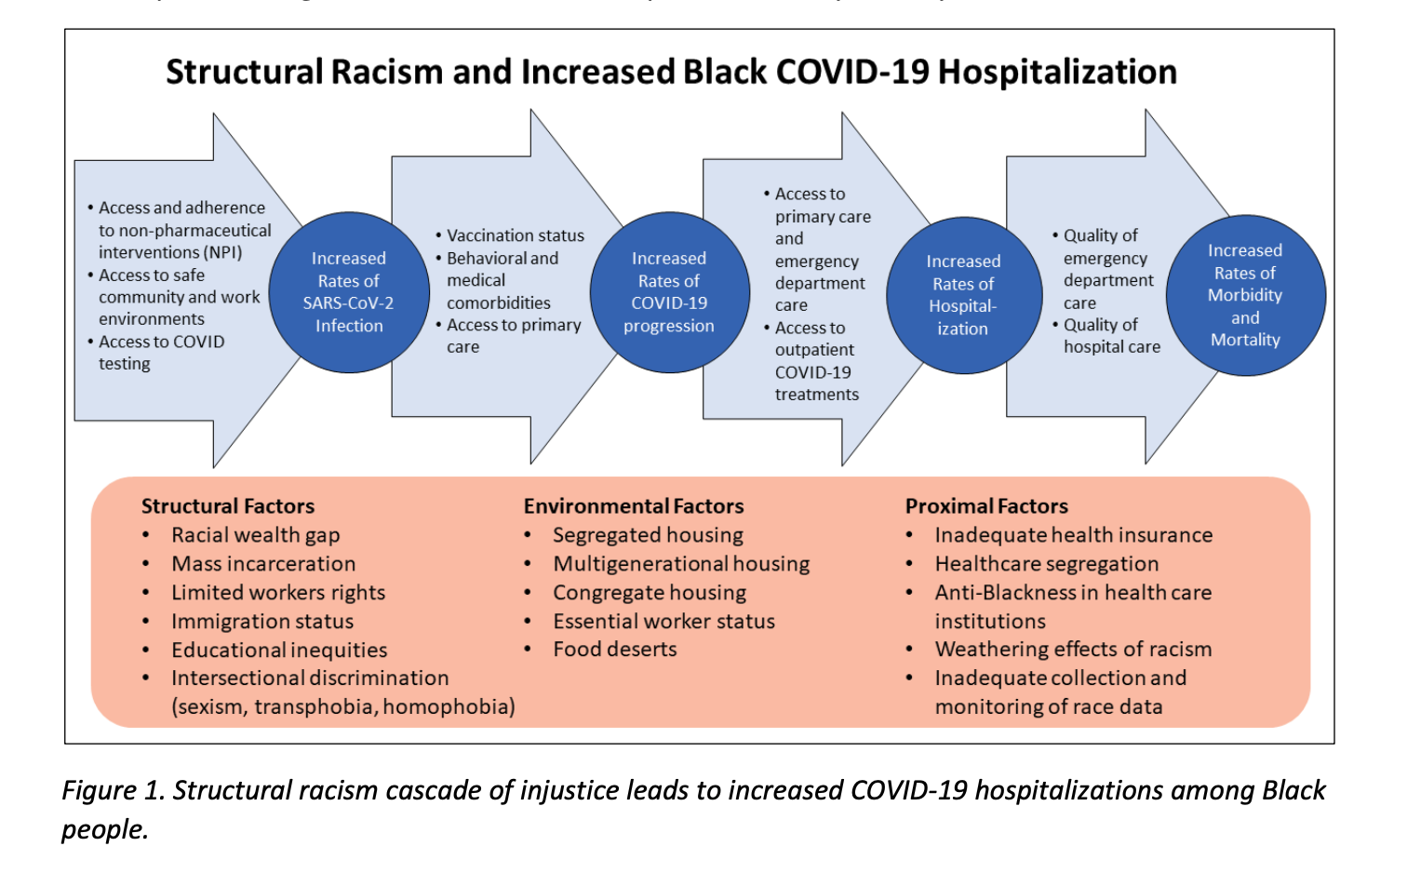
INSIGHTS
The story tells:
Most of 1st & 2nd degree assault in New York from [2017-2021] were committed in:
Brooklyn
Queens
Bronx
By:
Black Male/Female
Age: 25-44
White Hispanic Male
Age: 25-44
The most affected with Covid-19 in 2020 were:
Blacks
Hispanics
As consequence, there was a decrease in 1st & 2nd degree assault in 2020 but as we return to normal, crime rates increases.
Source: https://www1.nyc.gov/assets/doh/downloads/pdf/covid/black-hospitalizations-omicron-wave.pdf
Notes:
Source: https://www1.nyc.gov/assets/doh/downloads/pdf/covid/black-hospitalizations-omicron-wave.pdf

Slide 23
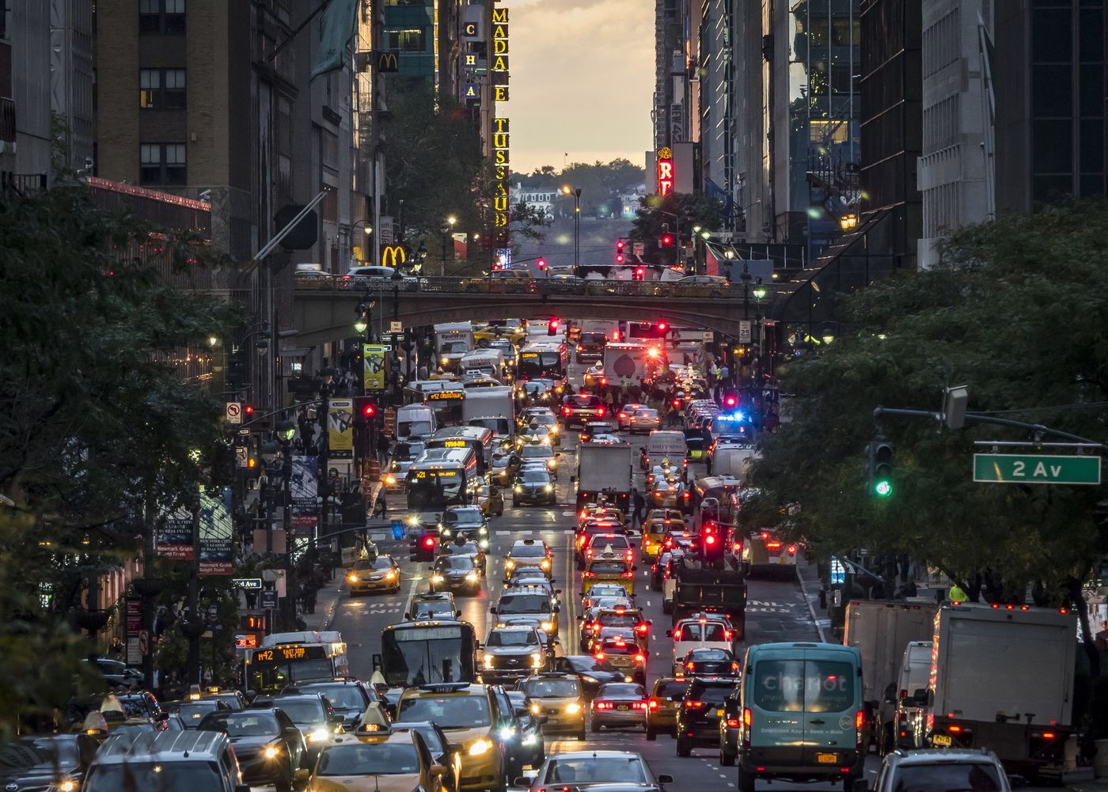
Traffic
Example of traffic violations as misdemeanor:
Leaving the scene of accident
Driving without insurance
Reckless driving
Driving under the influence
Driving while impaired
Fleeing from law enforcement officers
Driving while license is suspended
Vehicular homicide
Penality
The possible penalties for criminal traffic offenses can vary substantially, depending upon the crime with which you have been charged.

Slide 24
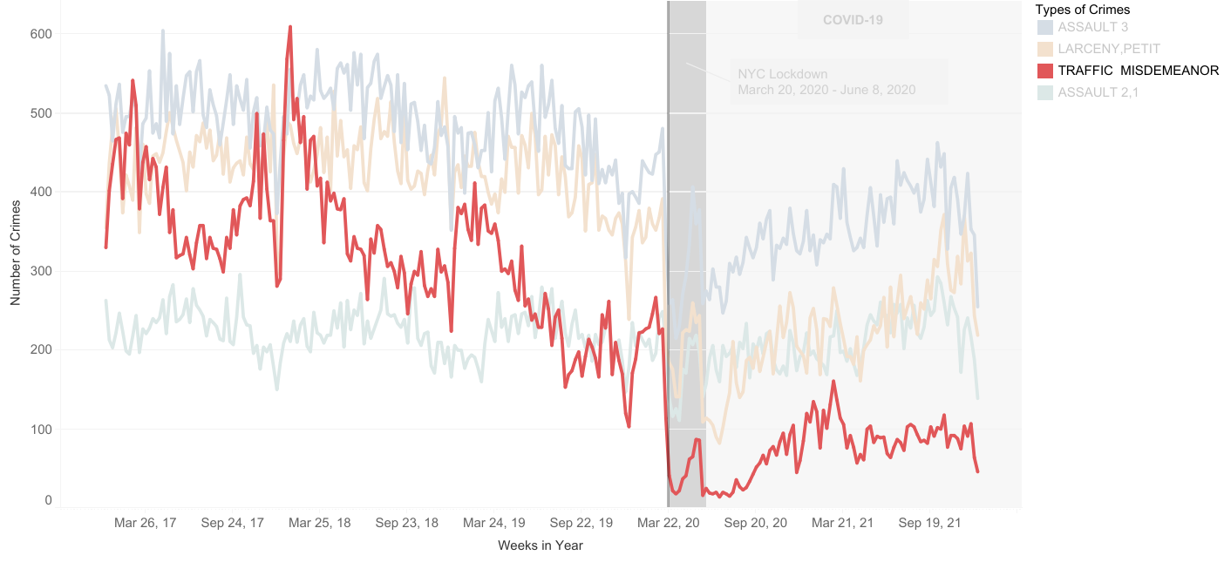
Traffic Observation

Slide 25
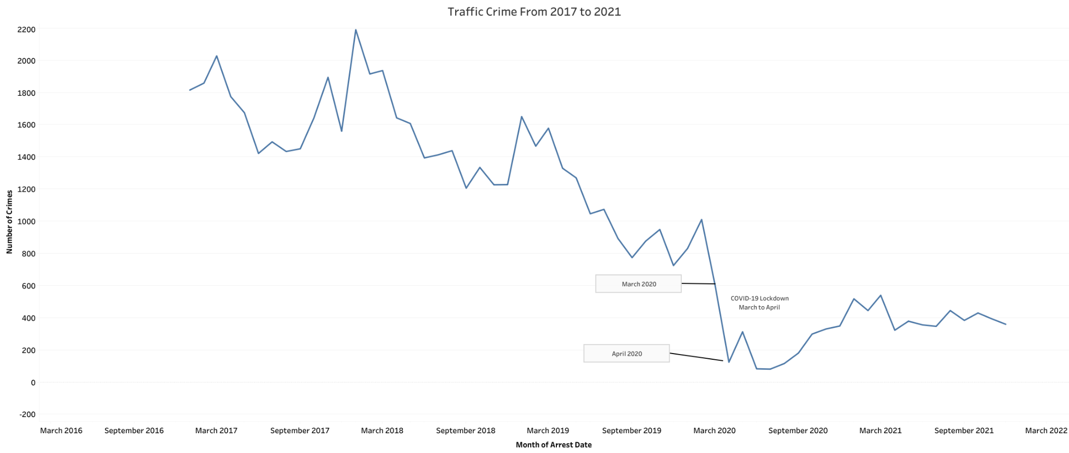
Traffic Observation
Traffic crime from 2017 to 2022
Decline in 2020, due to Covid-19
March 2021 and onwards has seen a rise again

Slide 26
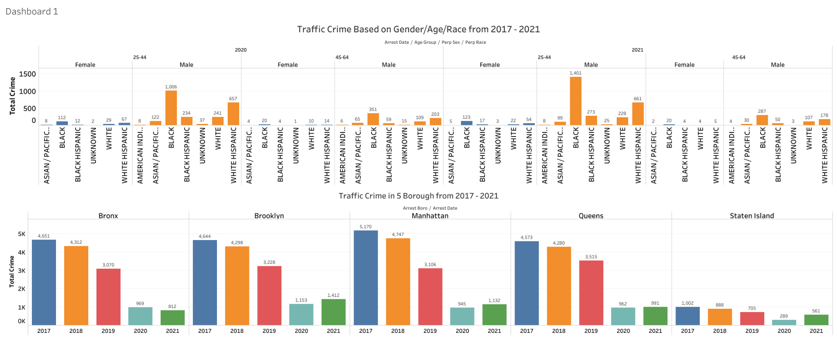
Traffic Observation
Majority of Traffic Violation is by
Gender : Male
Race : Black
Age-group : 25-44
From 2017 to 2018 Manhattan has the most traffic violation
From 2020 to 2021 Brooklyn has the most traffic violation
Traffic crime decreased in 2020 and 2021 due to Covid-19

Slide 27
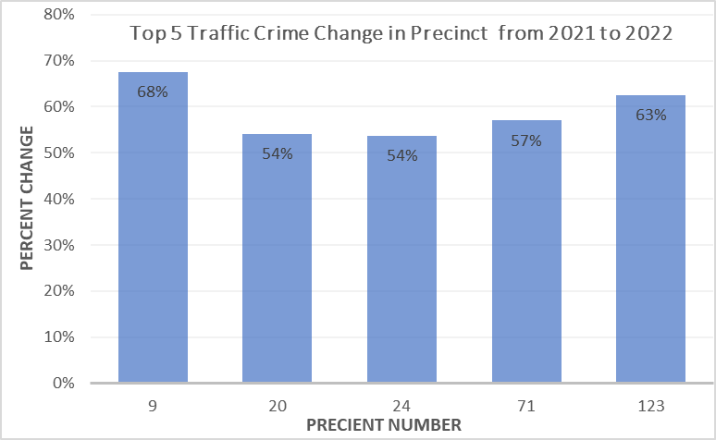
Top 5 Traffic Crime Change
Precinct Location:
Manhattan
9
20
24
Brooklyn
71
Staten Island
123

Slide 28
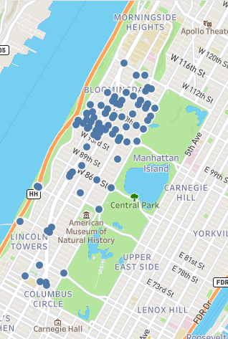
Precinct 20 & 24
(Upper West Side of Manhattan)
Central Park
Hotels
Offices
Tourist attraction
Residential

Slide 29
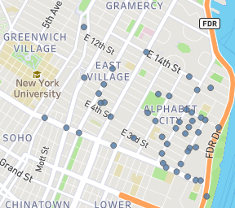
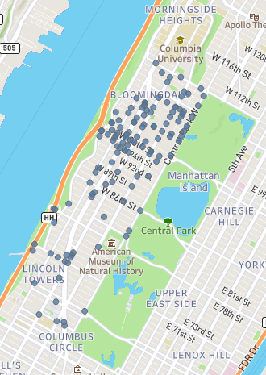
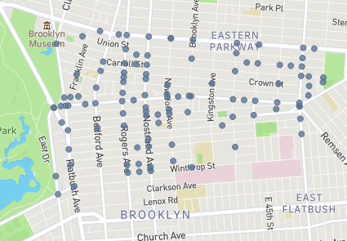
Precinct 9 Precinct 20 & 24 Precinct 71
Museum
Bars
Central Park
Hotels
Offices

Slide 30
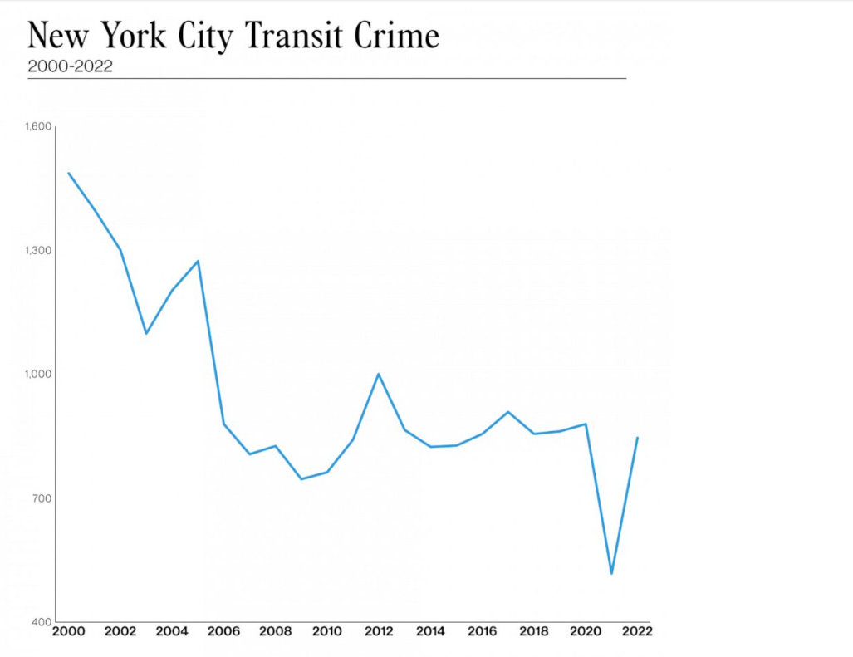
Traffic Insight
New Yorkers are avoiding taking public transportation due to:
People are concerned about Covid
Crime in subway has been increasing

Slide 31
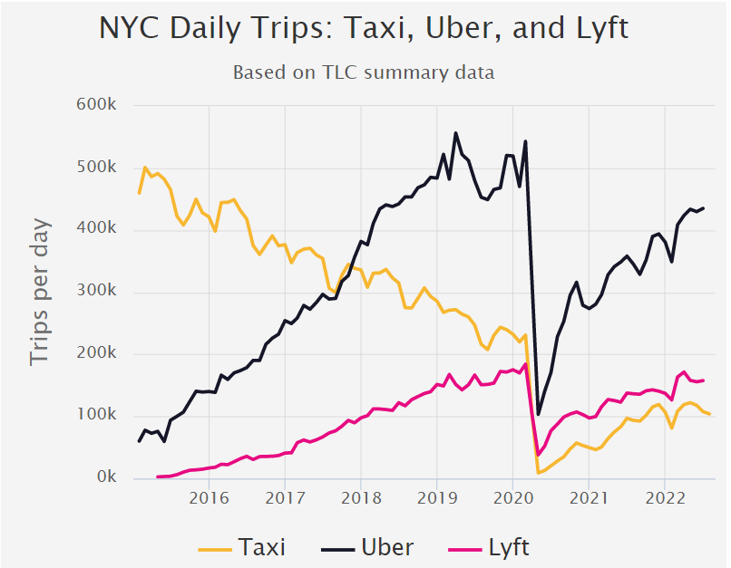
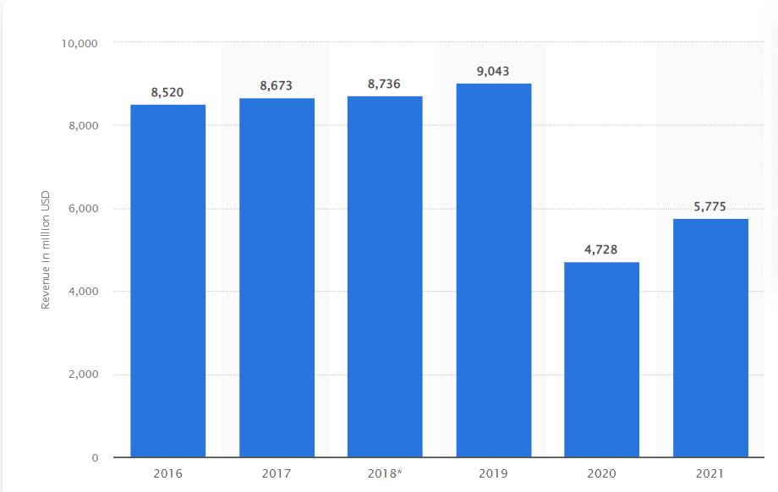
“...with fewer riders, the city’s public transit organization is facing its worst budget crisis in history” - NYTimes
“Public-transit use in some areas, despite the companies’ claims, has been waning, according to several studies, as more consumers opt to jump in Ubers and Lyfts that drive them door to door” - NYTimes
“ … many residents experiencing homelessness are seeking shelter on trains -- from top to bottom the COVID-19 pandemic has overwhelmed New York's public transportation system and its staff. - ABC News

Slide 32
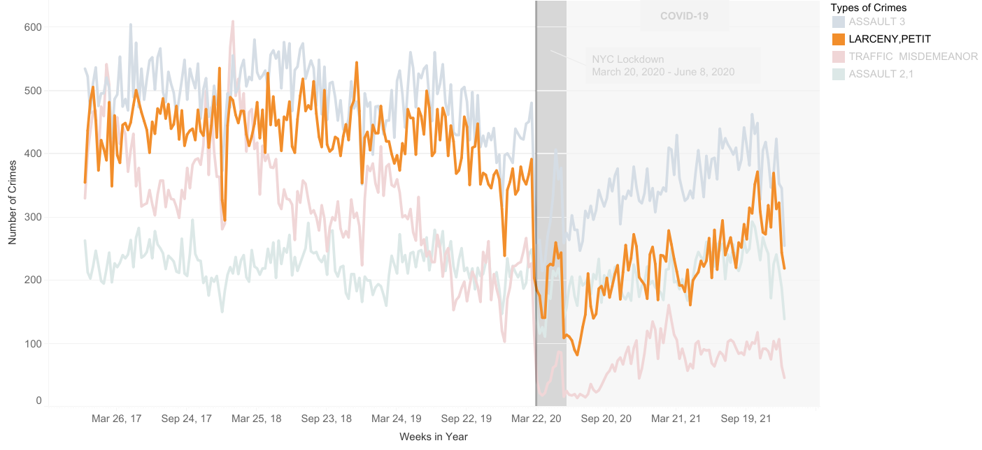
Petit Larceny

Slide 33
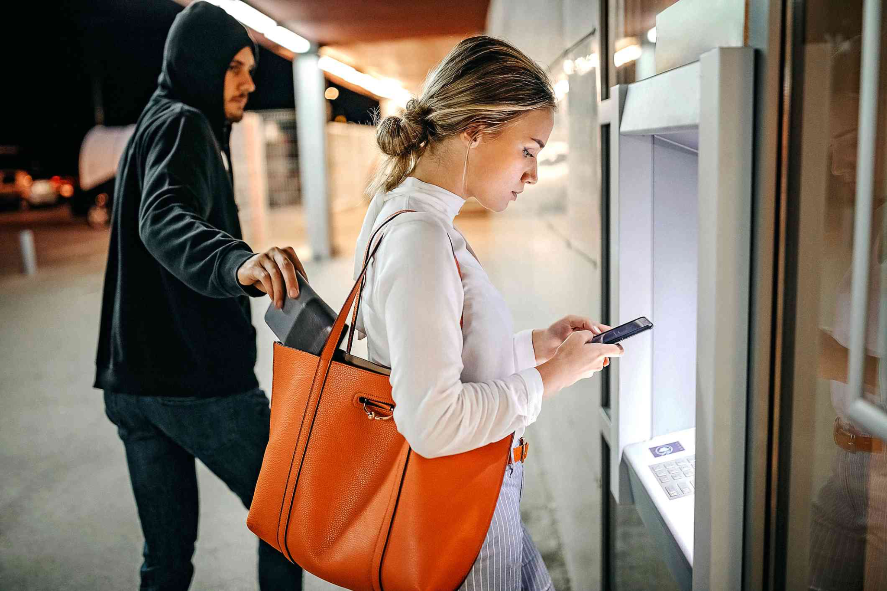
Petit Larceny
Petit larceny is the lowest level of larceny and is considered a class A misdemeanor making it one of the most severe of misdemeanor crimes.
It is the stealing of property worth under $1,000 or less. However, there are exceptions. Stolen items such as credit cards, firearms, and religious items worth more than $100 are considered grand larceny.
- Examples:
Shoplifting (most common)
Using undoctored (fake) MetroCards
Stealing mail
Removal of items from rental property
The penalty for petit larceny
Sentenced 2-3 years of probation
Fined up to $1,000
A year sentence in a county or city jail

Slide 34
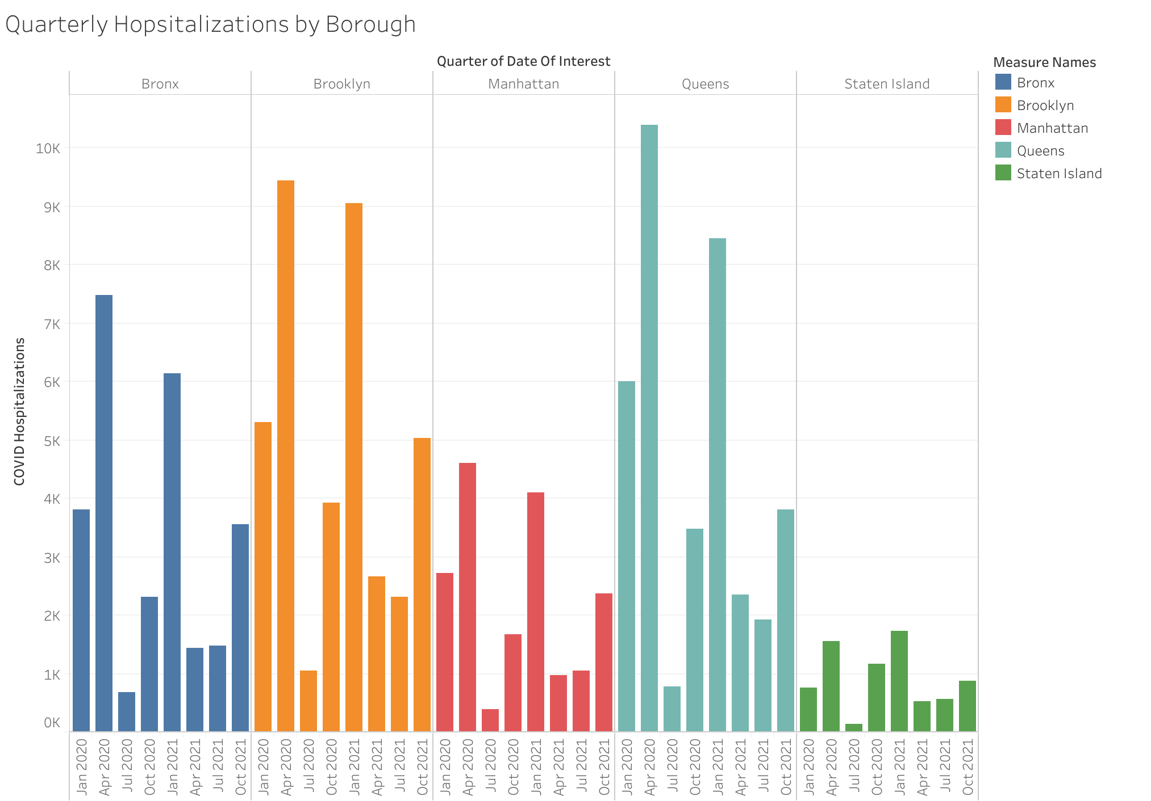
Notes:
The boroughs hit hardest by the pandemic in the first quarter (in descending order):
Queens (1), Brooklyn (2), Bronx (3), Manhattan (4), Staten Island (5).
In the second quarter, hospitalizations were at their highest for each borough except for Staten Island(In descending order):
*same as above.

Slide 35
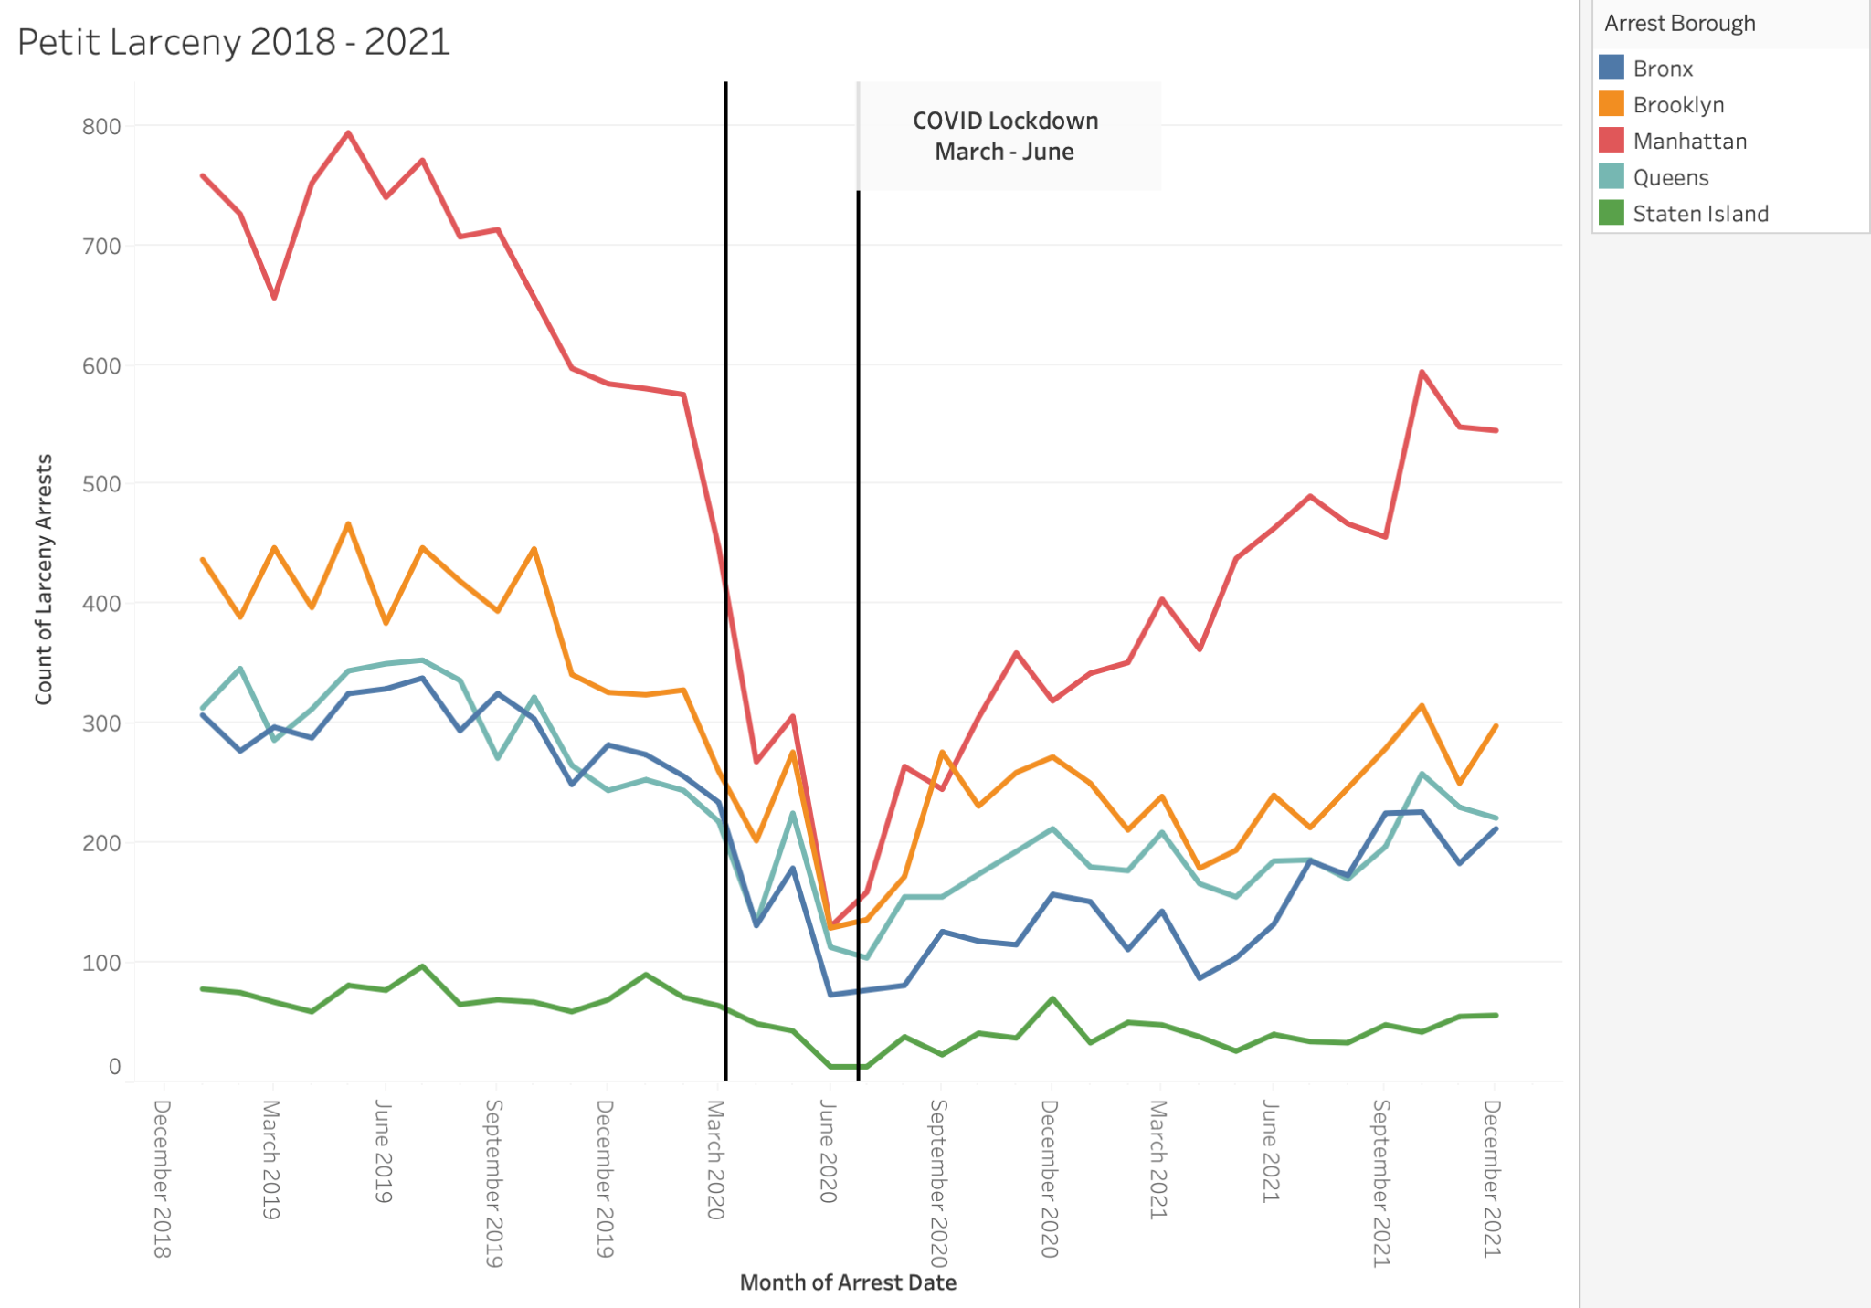
Notes:
During the start of the lockdown, larceny arrests dropped significantly. Larceny arrests peaked towards the end of May.
(First line represents start of lockdown in March; Second line is the end in June).
(Points are peak larceny arrests in the middle of May).

Slide 36
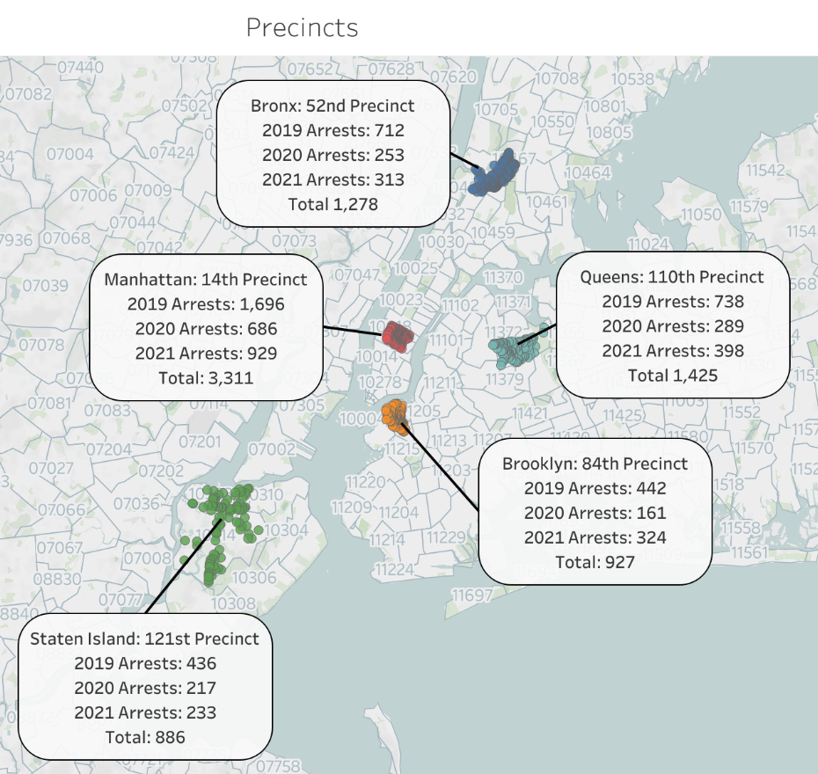
Manhattan’s 14th precinct being in the wealthiest borough, has the highest overall larceny arrests. It is near the garment district and many subway stations.
Queens’ 110th precinct is located near many schools
Bronx is the least wealthy borough. 52nd precinct is located near several parks and schools
Brooklyn’s 84th precinct located near hotels and restaurants
Staten Island’s 121st precinct has the lowest larceny arrests overall and is the safest borough

Slide 37
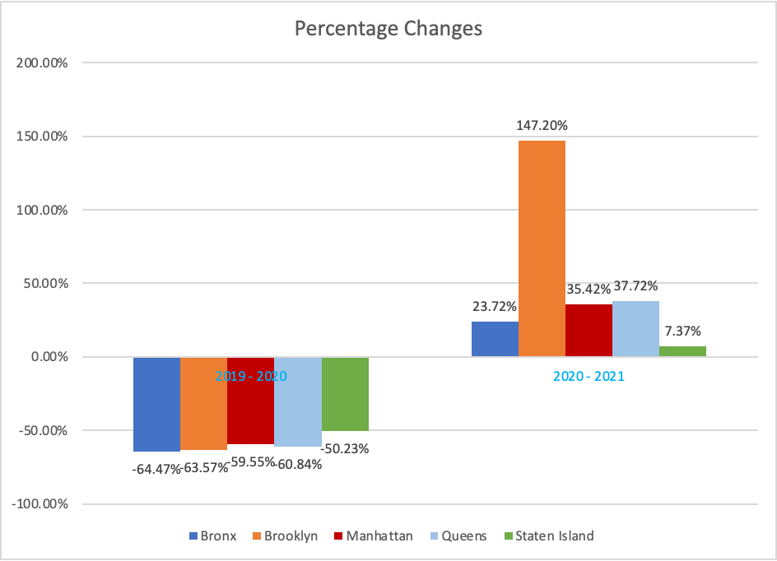
A significant decrease in larceny arrests in these precincts in 2020. This can be attributed to the pandemic. Fewer people outdoors from the stay at home mandate.
In 2021 arrests increased for each of these precincts with Brooklyn’s 84th precinct being the highest.
Brooklyn’s 84th precinct had the highest increase in of larceny with a 147 percent increase in arrests in 2021

Slide 38
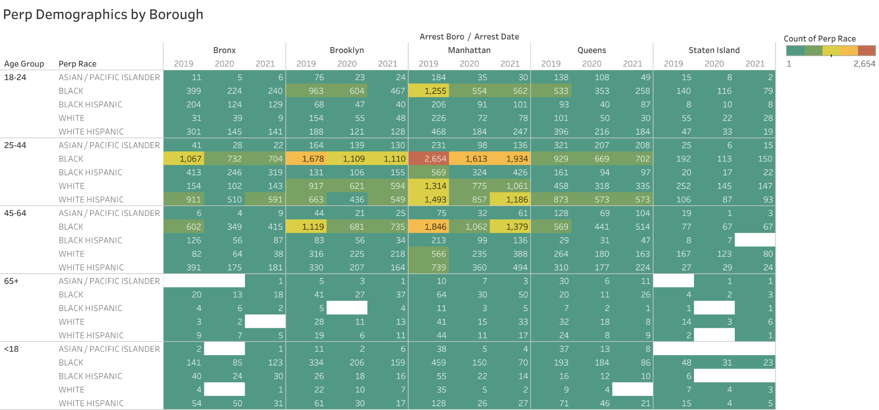
In each borough, people who committed larceny the most were black, aged 25 - 44.
2019 had the highest count in all boroughs with the highest being in Manhattan and Brooklyn.
Larceny declined in 2020 and began to increase in 2021 as NYC began to reopen
Notes:
The majority of larceny perpetrators were male and black. 2020 has fewer arrests due to the NYC lockdown.

Slide 39
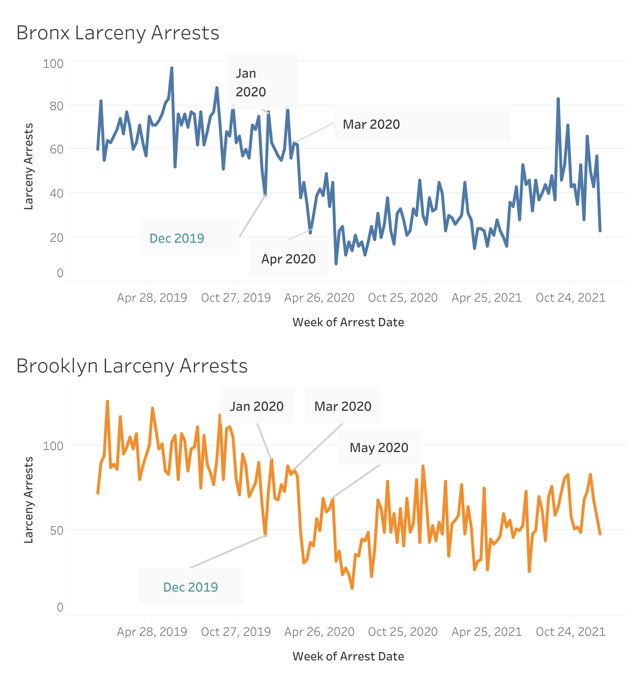
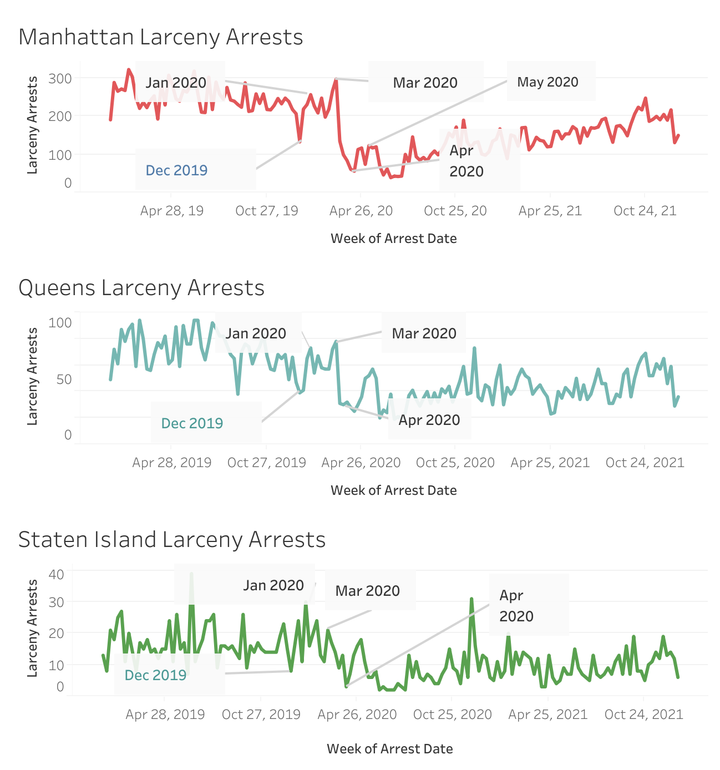
Insights
All boroughs: Jan 2020 sudden increase in larceny due to bail reform. Eliminated cash bail for misdemeanors including petit larceny
Mar 2020 an increase in arrests related to the release of prisoners. Highest in Manhattan & Brooklyn
Apr 2020 a steep decline in arrests resulting from the homeless sheltering in hotels
May 2020 protests in Manhattan & Brooklyn slight increases in arrests
As NYC reopened arrests have sporadically increased

Slide 40
Conclusions/Recommendations
How did Covid-19 impact the amount of crime in New York City?
Job loss, food insecurity, economic fallout, lack of healthcare in some neighborhoods
Recommendations:
Investment in priority neighborhoods to improve healthcare access, including vaccination, Covid-19 treatments, and mental health to reduce the amount of people affected by the next pandemic
More NYPD presence in neighborhoods with heavier crime rates
Install more speed cameras in places with heavy traffic
Improve public transportation so it can be alternative for commuters

Slide 41
Metadata
Dataset: Arrest Data Historic [2017-2021]
Agency: Police Department (NYPD)
Link: https://data.cityofnewyork.us/Public-Safety/NYPD-Arrests-Data-Historic-/8h9b-rp9u/data
Dataset: COVID-19 Daily Counts of Cases, Hospitalizations, and Deaths
Agency: Department of Health and Mental Hygiene (DOHMH)
Link: https://data.cityofnewyork.us/Health/COVID-19-Daily-Counts-of-Cases-Hospitalizations-an/rc75-m7u3
Dataset: Individual Census by Borough, Community District, and Facility Type
Agency: Department of Homeless Services (DHS)
Link: https://data.cityofnewyork.us/Social-Services/Individual-Census-by-Borough-Community-District-an/veav-vj3r

Slide 42
Citations
https://abcnews.go.com/US/recent-shootings-york-city-transit-crime-holds-steady/story?id=84908004
https://toddwschneider.com/posts/taxi-uber-lyft-usage-new-york-city/?fbclid=IwAR1U81JeTLUzbh2oXUj-eyHX1yxNTK5ZgvtcCVuGDFdSAAViEFMHhMf16Rw
https://www.statista.com/statistics/1285496/annual-revenue-mta-new-york-public-transport/#:~:text=The%20annual%20operating%20revenue%20of,compared%20to%20the%20previous%20year.
Assault in the First and Second Degree definitions , https://www.new-york-lawyers.org/assault.html
Racial Inequities in COVID-19 Hospitalizations, https://www1.nyc.gov/assets/doh/downloads/pdf/covid/black-hospitalizations-omicron-wave.pdf
Covid-19 pandemic in New York City
Covid-19 pandemic New York State
Bail reform
3rd Degree Assault definition
Financial District
Census Reporter
Impacts of COVID-19 on Mental Health in New York City, 2021

Slide 43
THANK YOU
Q/A

Slide 44

Crime that happened more often from 2017 to 2021

Slide 45



